Slide 1
Project for Odisha
HELPING PEOPLE IN ODISHA SPIRITUALLY AND PHYSICALLY THROUGH PRIMARY HEALTH CARE

Slide 2
About Odisha
Orissa, also known as Odisha, is located on the South East coast of India, by the Bay of Bengal.
The spoken language is Odia
The state is known for its unintended coastline, which is 480 km long. Historically Orissa was known as Kalinga and was invaded by the Mauryan Emperor Ashoka.
The capital of Orissa is Bhubaneswar, which is also known as the Temple City of India.
Orissa has a population of 41,947,358 (2011 census) and covers an area of 155,820 km sq.
Districts and Administration of Orissa: Orissa is divided into 30 districts and each district is governed by a district magistrate who is appointed by the Orissa Administrative Services or the Indian Administrative Services. Each district is split into sub divisions, which are overseen by a sub divisional magistrate. These sub divisions are further divided into blocks and blocks into town municipalities and village panchayats.

Slide 3
S No. | District | Headquarters | Population (Census 2011)
1 | Angul | Angul | 1,273,821
2 | Balangir | Balangir | 1,648,997
3 | Baleshwar | Balasore | 2,320,529
4 | Bargarh | Bargarh | 1,481,255
5 | Bhadrak | Bhadrak | 1,506,337
6 | Boudh | Boudh | 441,162
7 | Cuttack | Cuttack | 2,624,470
8 | Debagarh | Debagarh | 312,520
9 | Dhenkanal | Dhenkanal | 1,192,811
10 | Gajapati | Paralakhemundi | 577,817

Slide 4
S No. | District | Headquarters | Population (Census 2011)
11 | Ganjam | Chhatrapur | 3,529,031
12 | Jagatsinghpur | Jagatsinghpur | 1,136,971
13 | Jajpur | Panikoili | 1,827,192
14 | Jharsuguda | Jharsuguda | 579,505
15 | Kalahandi | Bhawanipatna | 1,576,869
16 | Kandhamal | Phulbani | 733,110
17 | Kendrapara | Kendrapara | 1,440,361
18 | Kendujhar | Kendujhar | 1,801,733
19 | Khordha | Khordha | 2,251,673
20 | Koraput | Koraput | 1,379,647

Slide 5
S No. | District | Headquarters | Population (Census 2011)
21 | Malkangiri | Malkangiri | 613,192
22 | Mayurbhanj | Baripada | 2,519,738
23 | Nabarangapur | Nabarangpur | 1,220,946
24 | Nayagarh | Nayagarh | 962,789
25 | Nuapada | Nuapada | 610,382
26 | Puri | Puri | 1,698,730
27 | Rayagada | Rayagada | 967,911
28 | Sambalpur | Sambalpur | 1,041,099
29 | Subarnapur | Subarnapur | 610,183
30 | Sundergarh | Sundergarh | 2,093,437

Slide 7
Religious composition in Odisha according to the 2001 census
Religious composition in Odisha according to the 2001 census^{[1]}
Religion | Persons | %persons | Males | %males | Females | %females
Hindus | 34,726,129 | 94.35% | 17,615,951 | 94.40% | 17,110,178 | 94.30%
Christians | 897,861 | 2.44% | 443,245 | 2.38% | 454,616 | 2.51%
Muslims | 761,985 | 2.07% | 391,234 | 2.10% | 370,751 | 2.04%
Sikhs | 17,492 | 0.05% | 9,448 | 0.05% | 8,044 | 0.04%
Buddhists | 9,863 | 0.03% | 5,180 | 0.03% | 4,683 | 0.03%
Jains | 9,154 | 0.02% | 4,736 | 0.03% | 4,418 | 0.02%
Others | 361,981 | 0.98% | 180,156 | 0.97% | 181,825 | 1.00%
Religion not stated | 20,195 | 0.05% | 10,620 | 0.06% | 9,575 | 0.05%
Totals | 36,804,660 |  | 18,660,570 |  | 18,144,090

Slide 8
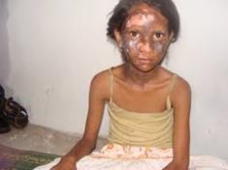
Religious violence in Odisha

Slide 9
About KANDHMAL DISTRICT
The tribe is Kandha
The spoken language is Kuia
The believe system are nature and animistic forms of Hinduism
The religions:
* Ethnic religionist - 0.05%
* Hinduism - 94.35%
* Christianity - 2.44%
* Others
Occupation: Mainly forming! Vegetables, Ground
nets, Turmeric & Turmeric powder.

Slide 10
Strong holds in Odisha

Slide 11
believes

Slide 12
traditions of Odisha

Slide 14
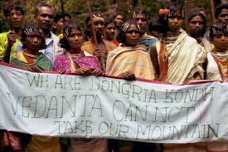
Kandhamal district contains several tribal reservations where only tribal people can own land. The largest community in Kandhamal is the Kandha tribe. However, the socio-economic and political landscape of Kandhamal is dominated by its second largest community, the non-tribal Pana caste.

Slide 15
Terrorist

Slide 16
Common Diseases in odisha
* Genetic disorders such as sickle cell disease and beta-thalassemia, will continue to gain greater prominence in the overall spectrum of ill health.
The spectrum of hemoglobin variants
Sickle cell disease 80%
Hemoglobinopathy
* Tuberculosis - 23%
* Renal infection
Typhoid - 14%
* Malaria - 94%
Cerebral malaria - 65%
Other types of malaria - 39%

Slide 17
Way of Approaching
* Presenting varies kinds of programs:
Awareness programs about Hygiene & about Diseases.
Showing pictures by using of flip charts.
Showing related movies.
Primary Health Care Clenic
* Programs should be conducted in:
In Schools
In Churches
In Community Halls
In open areas

Slide 18
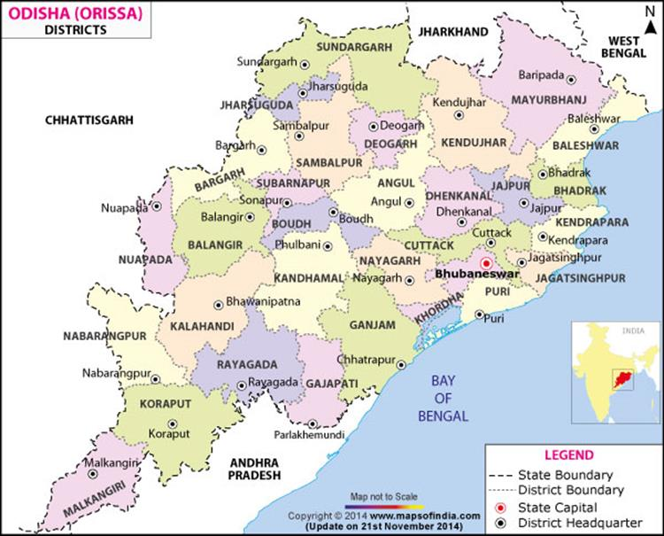
Map of Odisha
Notes:
Four Air-Port in Andhra Pradesh! Imagine how big the state is!

Slide 19
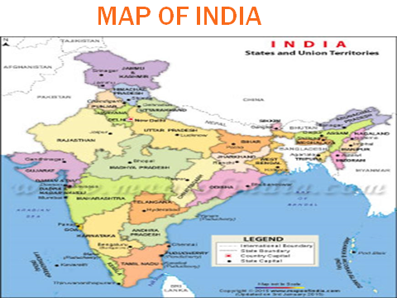

Slide 20
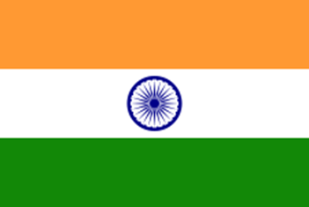

Slide 21
Prayer points
* Prayer Points For India:
Please pray for India and especially Eastern part of India, which re-present as a non developed area. Areas like Odisha, Assam & West Bengal.
Please pray for Odisha and especially Kandhamal District , where persecutions takes place often.
Please pray for the souls to receive the salvation.
* Common Prayer Points:
Please pray for Nepal to rebuild.
Please pray for the souls to receive the salvation.
Please pray for the Christians Pastors, Missionaries & Believers of Christ.
Please pray for the economic situation in the world.
Please pray for the terrorist, let them get out of the evil actions.
Please pray for the leaders of the nations.
Please pray for the child traffics.
Please pray more things as God leads you.

Slide 22
Thank you!

