Slide 2
GOD IS LIFE: He desires a relationship
GOD CREATED MANKIND TO HAVE LIFE AND TO LIVE IN RELATIONSHIP WITH HIM AND WITH OTHERS.
“And the LORD God formed man of the dust of the ground, and breathed into his nostrils the breath of life; and man became a living soul.” (Genesis 2:7 KJV)
"You shall love the Lord your God with all your heart, and with all your soul, and with all your strength, and with all your mind; and your neighbor as yourself." (Deut. 6:5; Lev. 19:18b)
"‘For I know the plans that I have for you,’ declares the LORD, ‘plans for welfare and not for calamity to give you a future and a hope.'" (Jeremiah 29:11)

Slide 3
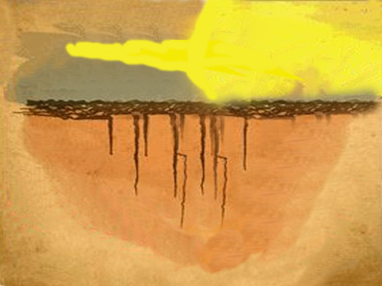
God
Me
soul
is holy, righteous, and is Life
Spirit
TRUTHS
I’m alive and connected to God by His Spirit, the breath of life.
God created a soul in me. The soul is created to be spiritually connected to God.
God greatly values and loves me.
God desires my love.
God desires me to love myself.
God desires for me to love my neighbors as myself.
God has a personal plan and future for me.
God has a plan for me, my neighborhood, and my world!

Slide 4
Mankind’s Issue: All Have Sinned. (Romans 3:23)
HUMANKIND DID NOT PUT THEIR RELATIONSHIP WITH GOD FIRST IN THEIR LIFE. THIS WAS SIN.
No Person Perfectly Does What They Know To Do:
1) “They have committed abominable deeds; there is no one who does good.” (Psalms 14:1) 2) ”For whoever keeps the whole law and yet stumbles in one point, he has become guilty of all.” (James 2:10)
Sin is breaking God’s relationship code with Him. Sin is breaking God’s law, and it causes a separation in the relationship. Look through the small samplings of God’s relational decrees on the page to the right, to discover what sin is. Ask yourself if you have lived a perfect life.

Slide 5
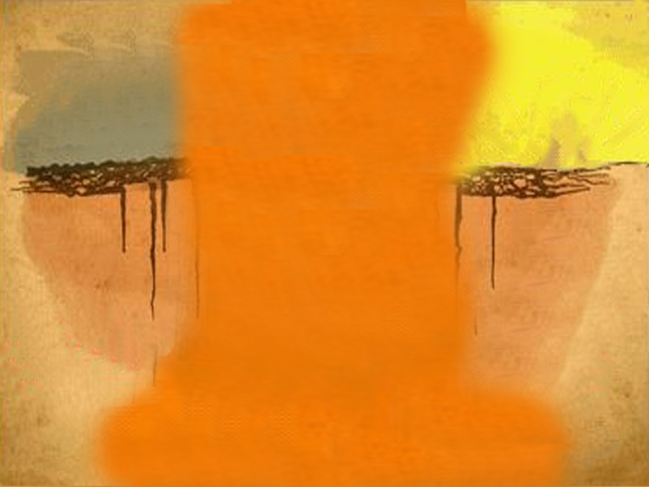
SIN IS…
- Not putting God first in your
life
- Having things in your life that
take you away from
worshipping the Lord God
- Using God’s name in a joking,
\or unholy way
- Avoiding meeting together
with other believers in Christ
for rest and encouragement
- Not honoring your parents
- Murder, Hating, Causing
Divisions, Jealousy, Envy
- Adultery, Impurity, Sexual Sins
- Stealing
God
Me
is holy, righteous, and is Life
- Lying
- Coveting, Use of Witchcraft, Palm Readers, Sorcery, Etc. (cf. Ex. 20:1-14; Matt:5:21-22, 28; Gal.5:19-21; Heb. 10:25)

Slide 6
God is Life. Sin separates you from God. The result is Death.
GOD SAYS… “The wages of sin is death...” Romans 6:23a
Because God is holy and righteous, sin cannot stay in His presence. When people choose to sin, they choose to have their spirit and soul separated from the life-giving Spirit of God. Therefore, the wage or result of the choice of sin is death. There are three deaths.
Spiritual death that separates a person from the wisdom, knowledge, love, and life of God (Is. 59:2; Eph. 2:1).
The next stage is physical death. This is where a person’s soul is separated from his or her body (Ec. 12:7; Heb. 9:27).
The final stage is eternal death where a person’s soul is eternally separated from God (Rev. 21:8).
Have you sinned?

Slide 7
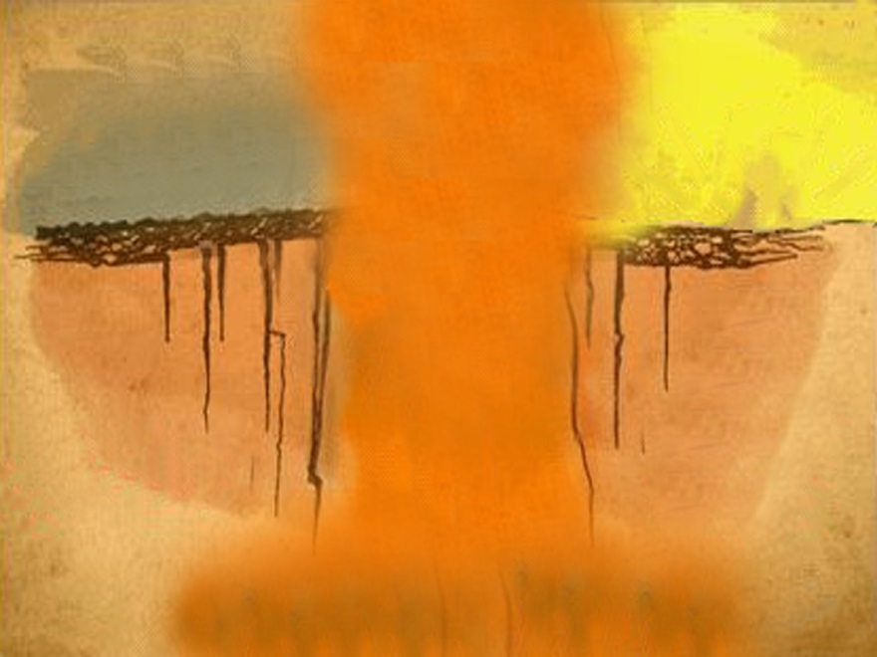
God
is holy, righteous, and is Life
Spiritual
Death
is holy, righteous, and is Life
“It’s your sins that have cut you off from God. Because of your sins, He has turned away and will not listen anymore.”
(Isaiah 59:2 NLT)
Mankind cannot continue to live cutoff from the breathe of life.
Physical
Death
Eternal Death

Slide 8
How can mankind get through the sin barrier?
FORGIVENESS:
1) suffer all the wrong actions done to you;
2) release the offender from punishment;
3) without holding retaliation, bitterness, or anger inside yourself.
Since God is the giver of life, what does He have to suffer in order to forgive you? ______________ Hint: “The wages of sin is death….” Romans 6:23 *When you think about the definition of forgiveness, it means that nothing can be done by you, or a third party, to provide forgiveness. Only the person whom you sinned against can suffer the consequences of sin, release you from punishment, and choose to remove the sin barrier. *When dealing other people who take advantage of your forgiveness, or an abuser, seek professional help immediately. -

Slide 9
Mankind’s Issue: Sin
Good Works
God
Being Good
is holy, righteous, and is Life
Me
Sports Awards
Self-Help Gurus
Money
No person can do enough good things to bridge the barrier of their sin.
Great Career
What must God first do to forgive sin?
Knowledge
Observance of laws
Devotion to gods
Religion / Good Teachers
Eternal Death

Slide 10
Forgiveness asks God to suffer the “wages of sin” GOD HAD TO COME TO EARTH: “Now the birth of Jesus Christ was as follows: When His mother Mary had been betrothed to Joseph, before they came together she was found to be with child from the Holy Spirit.” (Matthew 1:18)
GOD HAD TO SUFFER AND CONQUER SIN: “The Son of Man [Jesus] must suffer many things. He will be rejected by the Jewish elders, the leading priests, and the teachers of the law. He will be killed and after three days will be raised from the dead.” (Luke 9:22 NCV)
GOD HAD TO PROVE HIS LOVE: “God demonstrates His own love for us, in that while we were still sinners, Christ died for us.” (Rom. 5:8)
GOD HAD TO SHOW HIS SACRIFICE WAS FOR ALL: “For Christ also died for sins once for all, the just for the unjust, so that He might bring us to God.” (1 Peter 3:18a)

Slide 11
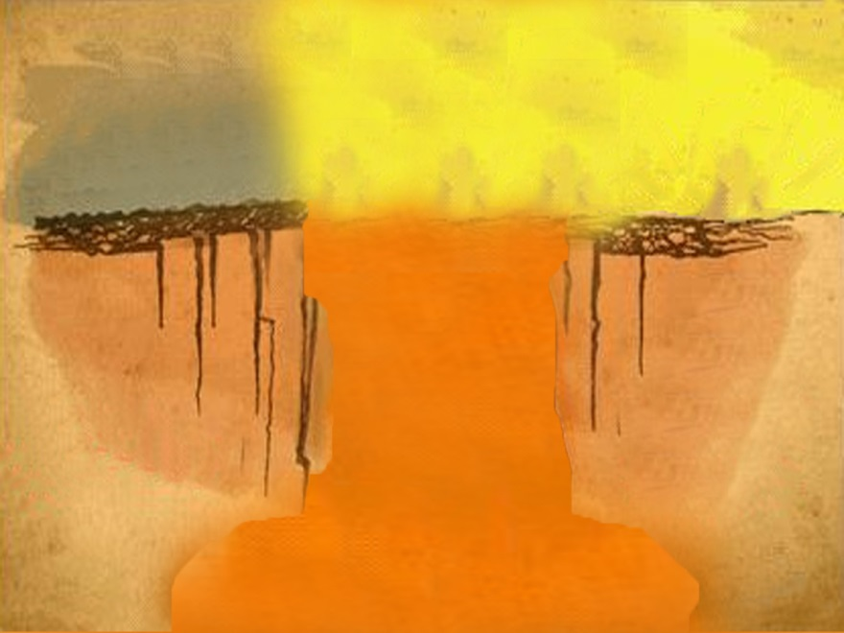
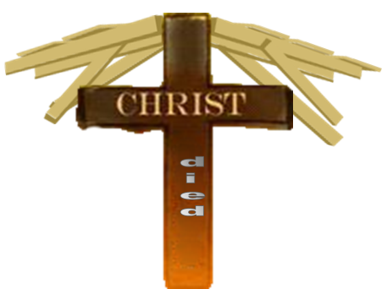
"When we were utterly helpless, Christ came at just the right time and died for us sinners." (Romans 5:6)

Slide 12
God Defines The Grace in Forgiveness Forgiveness: Romans 6:23
“The wages of sin is death” - Forgiveness petitions God’s forgiving nature to come to earth and suffer death for mankind.
1) suffer all the wrong actions done to you;
2) release the offender from punishment;
“but the free gift of God is eternal life in Christ Jesus” - Forgiveness is only found “in” the one whom you sin against. A person sins against God and His law first. Therefore, Jesus has to be God, not a god. Forgiveness is “in Jesus” – no other name!
3) without holding retaliation, bitterness, or anger inside yourself.
“our Lord.” - Jesus rose from the grave to fully conquer sin and forgive all who would believe in Him. Only by turning from your sins can He be our Savior, Lord, & Master.
“The wages of sin is death, but the free gift of God is eternal life in Christ Jesus, our Lord.” Rom. 6:23

Slide 13
Mankind’s Issue: Sin
God
Rom. 5:8
is holy, righteous, and is Life
Me
God must come to earth to make a way to God!
Consequence of sin: Death
Eternal Death

Slide 14
There is only one way…
When people first heard and believed the Good News, they asked what must we do to be saved? The reply is the foundation of salvation:
“Repent, and each of you be baptized in the name of Jesus Christ for the forgiveness of your sins; and you will receive the gift of the Holy Spirit.” (Acts 2:38)
The first hearers of the Gospel believed in their hearts.
They repented. Repent means to have a change of mind about your beliefs. When your beliefs change, so does the your life and lifestyle. Your life will always reflect your beliefs.
They were baptized “in” the name of Jesus. Baptize means immerse. Name means character and nature. Believers were immersed in water to show they had been cleansed and empowered by the Holy Spirit and had begun to take on the character and nature of Christ to be His followers. This type of faith is the eye-opening bridge to forgiveness!

Slide 15
Mankind’s Issue: Sin
God
is holy, righteous, and is Life
Me
John 14:6
Forgiveness is the free gift of grace that will restore a relationship “if” accepted!
Jesus has to be God to pay the price of sin. A third party cannot provide forgiveness!
Eternal Death

Slide 16
A FREE GIFT OF GOD & THE OBEDIENCE OF FAITH
Jesus fulfilled close to 300 prophecies that were written hundreds of years before His arrival. He told the world He would die on the cross for their sins. Jesus knew He was God and what He had to do to provide forgiveness. His closest followers witnessed the resurrection. They died horrid deaths spreading the Good News. They knew the truth. They would not have died for a lie.
There are almost twice as many prophesies of Christ returning to judge believers and unbelievers. Upon His return to earth, He will fully establish His Kingdom and create a new earth. Those who have truly believed and accepted Jesus’ gift of forgiveness will begin to be changed by Jesus’ love. They will begin living by faith, looking forward to His return. Their faith in His death, resurrection, and return will shape how they currently live. If their beliefs about Jesus do not reshape their hope for living, then there will be no reason for life change to follow their faith. (cf. Romans 1:1-6)

Slide 17
Mankind’s Issue: Sin
God
is holy, righteous, and is Life
Me
John 1:12
A choice must be reasoned through.
Getting fire insurance will not work for a saving relationship with God!
Eternal Death

Slide 18
A REASON FOR CHANGE: “Then I saw a new heaven and a new earth, for the first heaven and the first earth had passed away...And I saw the holy city...coming down out of heaven from God, prepared as a bride adorned for her husband. And I heard a loud voice from the throne saying, ‘Behold, the dwelling place of God is with man. He will dwell with them, and they will be his people, and God Himself will be with them as their God. He will wipe away every tear from their eyes, and death shall be no more, neither shall there be mourning, nor crying, nor pain anymore, for the former things have passed away.’”
“…To the thirsty I will give from the spring of the water of life without payment. The one who conquers will have this heritage, and I will be his God and he will be My son. But as for the cowardly, the faithless, the detestable, as for murderers, the sexually immoral, sorcerers, idolaters, and all liars, their portion will be in the lake that burns with fire and sulfur, which is the second death.” (Rev. 21:1–8)
What will you choose to do?

Slide 19
Mankind’s Issue: Sin
God
is holy, righteous, and is Life
Me
2 Cor. 5:17
HOW CHANGE HAPPENS:
Change can happen when love for someone is greater than the pleasure a person finds in sin.
Other times, change can happen when the pain outweighs the pleasure derived from the sin a person currently enjoys. Sometimes a person needs to hit rock bottom before being ready to change.

Slide 20
To Help Clear Up Any Misunderstanding Concerning the Oneness of God.
The triune God has always existed, and God had in His heart that He was going to suffer the consequence of sin before He created mankind. THE PRE-EXISTENCE OF THE TRIUNE GOD: “God said, ‘Let Us make human beings in Our image...’” (Emphasis added, Genesis 1:26 NLT) THE PRE-EXISTENCE OF THE TRIUNE GOD: “He [Jesus] existed in the beginning with God. God created everything through Him, and nothing was created except through Him.” (John 1:2-3 NLT)
The coming Son of God in the form of a human life did not stop Him from being God when He came to earth. If Jesus was not God, He could not have suffered the consequences of sin and provided forgiveness. (Phil. 2:5-11) The diagram on the next page attempts to explain the trinity and the self-distinctions within the Godhead.

Slide 21
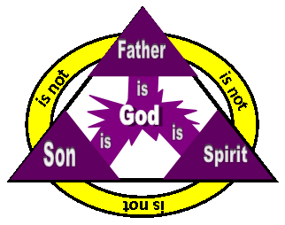
The Father, Son, and Holy Spirit have the fullness and essence of God as the diagram indicates, but each has His personal self-distinctions within the Divine essence. The Divine fullness and essence within Them keeps the oneness; therefore, it is said, “God is one.” (Mark 12:29). Before the foundation of the world, God knew the price of sin, and He knew what He would do when mankind sinned. That is love! God loves you and died for you! Jesus is God. Jesus is “the Lamb that was slain from the creation of the world.” (Revelation 13:8b NIV) God always knew He would come to earth to die to bridge the gap of sin for whosoever will believe! (John 3:16-17)

Slide 22
NEXT STEPS
Admit all the sins you can remember to God and ask for forgiveness.
Believe in the Lord Jesus Christ as the God who paid for your sin.
Confess to another believer what has taken place in your life.
Decide to be baptized in water. (Rom. 6:1-11)
Enjoy the filling of the Holy Spirit, Who will lead you in a new life.
Faithfully submit yourself to God and His elders who can teach you His Word at a local church.

Slide 23
Copyright © 2000 Tommy Bitner
“The Bridge to Forgiveness” MAY BE NOT BE COPIED OR EMAILED TO ANYONE WITHOUT WRITTEN PREMISSION.
Scripture quotations are from The Holy Bible, English Standard Version® (ESV®), copyright © 2001 by Crossway, a publishing ministry of Good News Publishers. Used by permission. All rights reserved.
Scripture taken from the HOLY BIBLE, NEW INTERNATIONAL VERSION. Copyright © 1973, 1978, 1984 International Bible Society. Used by permission of Zondervan Bible Publishers.
Scripture quotations marked "NKJV" are taken from the New King James Version. Copyright © 1979, 1980, 1982 by Thomas Nelson, Inc. Used by permission. All rights reserved.
Scripture taken from the NEW AMERICAN STANDARD BIBLE®, © Copyright The Lockman Foundation 1960, 1962, 1963, 1968, 1971, 1972, 1973, 1975, 1977. Used by permission.

